Slide 1

CELL MEMBRANE &
ITS FUNCTION

Slide 2
Learning objectives
At the end of lecture the students should be able to:
Identify the structure of Cell membrane
Recognize the Phospholipid bilayer and its composition
Differentiate between different types of Cell membrane proteins.
Recognize the function of cell membrane proteins and carbohydrates.

Slide 3
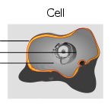
The Cell membrane
What are the basic components of a cell?
  cell membrane
  nucleus
  cytoplasm
cytosol
organelles

Slide 4
The cell membrane
also called the plasma membrane, which envelops the cell, is a thin, pliable, elastic structure.
only 7.5 to 10 nanometers thick.
It is composed almost entirely of proteins and lipids.
Is semipermeable, allowing some substances to pass through it & excluding others due to presence of numerous regulated ion channels & other transport proteins.

Slide 5
The nucleus is also surrounded by a membrane of this type
The different organelles like Mitochondria present with in cytoplasm are also surrounded by a membrane
Chemical structure of membranes & their properties vary considerably from one location to another.

Slide 6
The Cell Membrane
What does the cell membrane do?
  Creates separation between ECF vs. ICF
    Creates fluid compartments
  Regulates ECF – ICF exchange
  Allows for communication
  Provides structural support for cell and tissues

Slide 7
Functions Of Cell Membrane
Protective function: Cell membrane protects the cytoplasm and the organelles present in the cytoplasm.
Selective permeability: Cell membrane acts as a semi permeable membrane, which allows only some substances to pass through it and acts as a barrier for other substances.
Absorptive function: Nutrients are absorbed into the
cell through the cell membrane.
Excretory function: Metabolites and other waste products from the cell are excreted out through the cell membrane
Exchange of gases: Oxygen enters the cell from the blood and carbon dioxide leaves the cell and enters the blood through the cell membrane
Maintenance of shape and size of the cell: Cell membrane is responsible for the maintenance of shape & size of the cell.

Slide 8
The cell membrane
The approximate composition is:
Proteins, 55 %
Phospholipids, 25 %
Cholesterol, 13 %
other lipids, 4 % and
Carbohydrates, 3 %

Slide 9
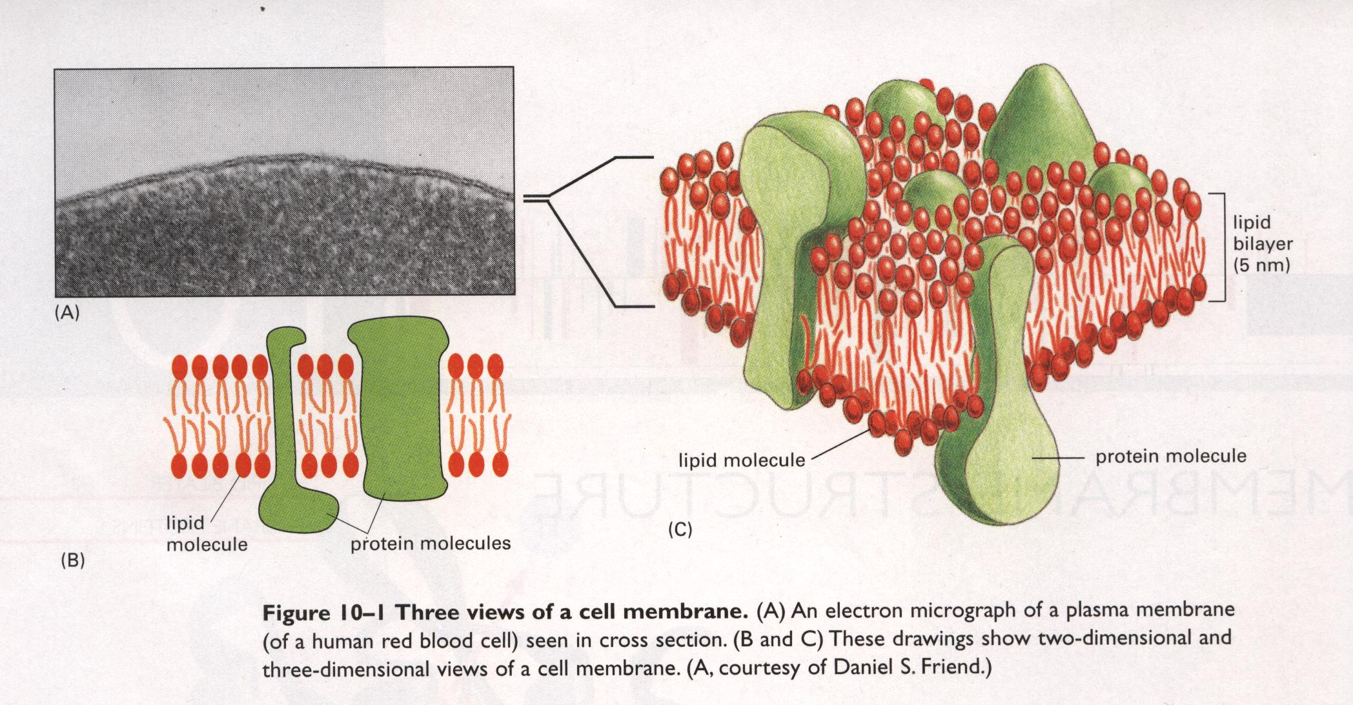

Slide 10
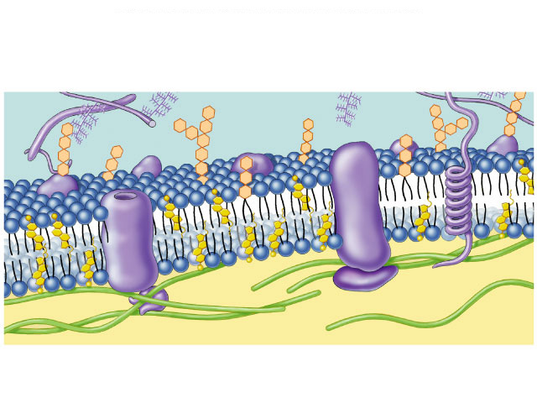
Membrane is a collage of proteins & other molecules embedded in the fluid matrix of the lipid bilayer
Glycoprotein
Extracellular fluid
Glycolipid
Phospholipids
Cholesterol
Transmembrane
proteins
Peripheral
protein
Cytoplasm
Filaments of
cytoskeleton
Notes:
The carbohydrates are not inserted into the membrane -- they are too hydrophilic for that. They are attached to embedded proteins -- glycoproteins.

Slide 11
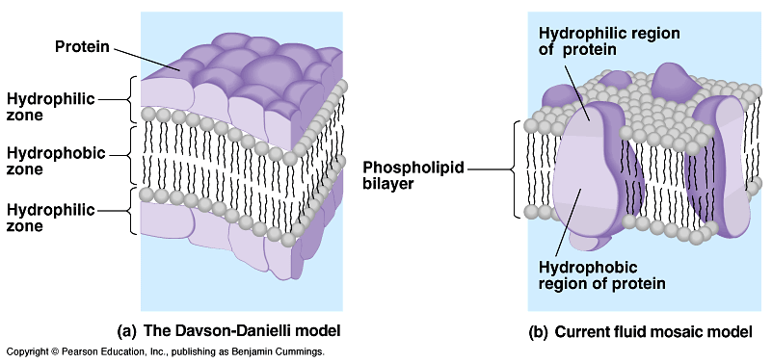
Fluid Mosaic Model
Membrane is a mosaic of
  Phospholipids
  Glycolipids
  Sterols
  Proteins
In 1972, S.J. Singer & GL. Nicolson proposed ‘The Fluid Mosaic Model’ According to them, the membrane is a fluid with mosaic of proteins. This model is accepted by the scientists till now.
In this model, the proteins are found to float in the lipid layer instead of
forming the layers of the sandwich-type model.

Slide 12
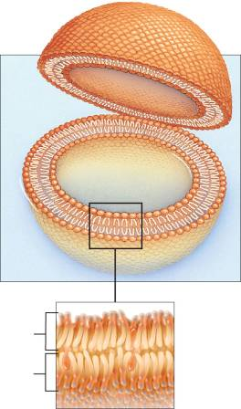
Lipid Bilayer
Main component of cell membranes
Gives the membrane its fluid properties
Two layers of phospholipids

Slide 13
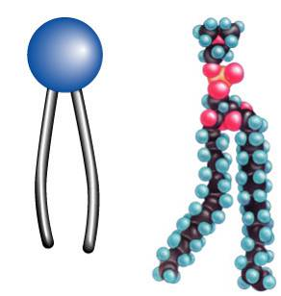
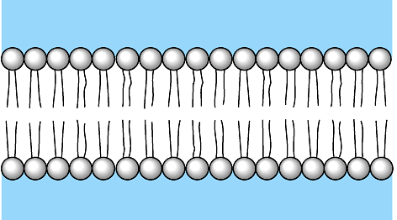
Phospholipids
Fatty acid tails
  hydrophobic
Phosphate group head
  hydrophilic
Arranged as a bilayer
Phosphate
Fatty acid

Slide 14
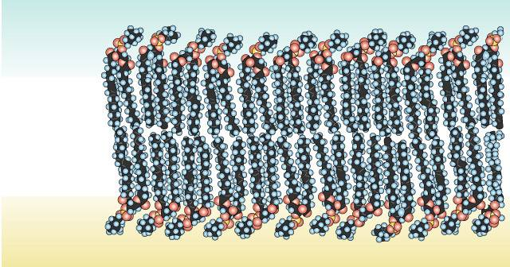
Phospholipid bilayer
polar
hydrophilic
heads
nonpolar
hydrophobic
tails
polar
hydrophilic
heads

Slide 15
The Cell Membrane
The physical barrier
  Formed by the tail to tail arrangement of the phospholipid molecules
    Self assembles into
liposomes
bi-layer membranes
miceles

Slide 16
The Cell Membrane
How does a barrier become a regulator?
  By being having a polar surface
  By specialized membrane components
hydrophillic heads
hydrophobic tails
hydrophillic heads

Slide 17
The Cell Membrane
Other phospholipid bilayer membrane components
  cholesterol
  sphingolipids
  Membrane proteins
  Glycoconjugates
Na⁺
ECF
ICF

Slide 18
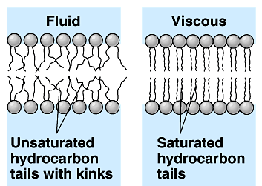
Membrane fat composition varies
Fat composition affects flexibility
  membrane must be fluid & flexible
  about as fluid as thick salad oil
% unsaturated fatty acids in phospholipids
  keep membrane less viscous

Slide 19
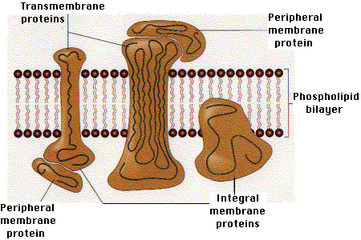
Membrane Proteins
They are present in the form of irregularly rounded masses.
Most of them are “Peripheral proteins.”
Some of them are “Integral or Trans-membrane proteins.”

Slide 20
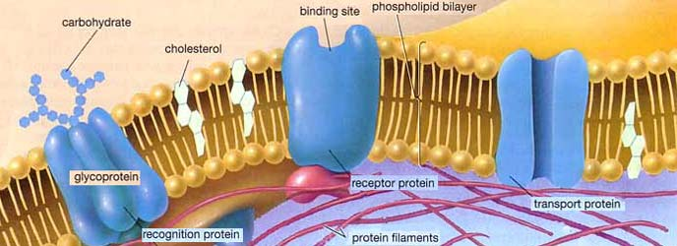
Membrane Proteins
Membrane proteins:
  Peripheral proteins
    loosely bound to surface of membrane
    cell surface identity marker (antigens)
  Integral proteins
    penetrate lipid bilayer, usually across whole membrane
    transmembrane protein
    transport proteins
      channels, permeases (pumps)

Slide 21
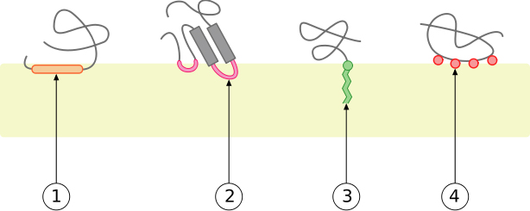
The Cell Membrane
Peripheral Proteins –
  attachments to the phospholipid bi-layer
interaction by a covalently bound membrane lipid (forms many sphingolipids)
interaction with alpha helix in transmembrane protein (not shown)
electrostatic or ionic interactions with membrane lipids
interaction by a hydrophobic loop

Slide 22
Functions Of Proteins
Integral proteins provide the structural integrity of the cell membrane.
Channel proteins help in the diffusion of water soluble substances like glucose and electrolytes.
Carrier or transport proteins help in the transport of substances across the cell membrane by means of active or passive transport.
Pump: Some carrier proteins act as pumps, by which ions are transported actively across the cell membrane
Receptor proteins serve as the receptor sites for hormones and neurotransmitters.
Enzymes: Some of the protein molecules form the enzymes and control chemical (metabolic) reactions within the cell membrane
Antigens: Some proteins act as antigens and induce the process of antibody formation
Cell adhesion molecules or the integral proteins are responsible for attachment of cells to their neighbors or to basal lamina.

Slide 23
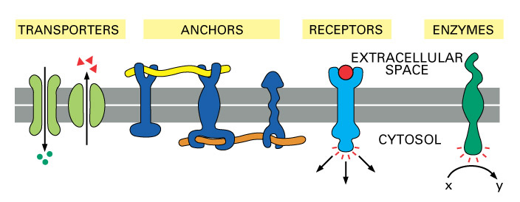
Functions of protein
Significance of proteins:-
1. Some proteins play vital role in transport across the membrane, and act as pump. Ions get attached to the protein on one surface and move with protein to the other surface.
2. Some proteins form passive channels through which substances can diffuse through the membrane.
3. Some proteins act as receptors for specific neurotransmitters or hormones.
4. Some proteins act as enzymes.

Slide 24
The Cell Membrane
Peripheral Protein Functions
  Enzyme function
    Mediate chemical reactions
  Structural
    Mediate attachment
  Transporters
    Between/among cell membrane proteins
  Electron carriers
    In electron transport chain
  Regulators
    Such as apoptosis

Slide 25
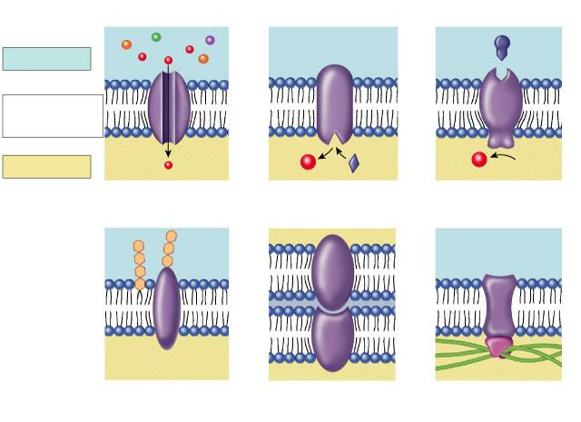
Many Functions of Membrane Proteins
Outside
Plasma
membrane
Inside
Transporter
Enzyme
activity
Cell surface
receptor
Cell surface
identity marker
Cell adhesion
Attachment to the
cytoskeleton
Notes:
Signal transduction - transmitting a signal from outside the cell to the cell nucleus, like receiving a hormone which triggers a receptor on the inside of the cell that then signals to the nucleus that a protein must be made.

Slide 26
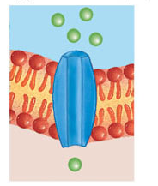
Channel protein

Slide 27
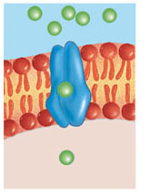
Carrier protein

Slide 28
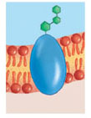
Cell recognition protein

Slide 29
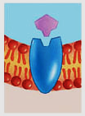
Receptor protein

Slide 30
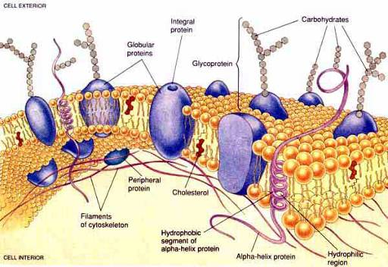
Carbohydrates
They are present at the surface of cell membrane.
They are attached either to the proteins (forming glycoproteins), or to the lipids (forming glycolipids).
Carbohydrate molecules form a thin and loose covering over the entire surface of the cell membrane called glycocalyx. Its thickness vary from 2 to 20 nm.

Slide 31
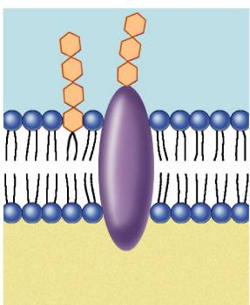
Function of membrane carbohydrates
Play a key role in cell-cell recognition
  ability of a cell to distinguish one cell from another
    antigens
  important in organ &
  tissue development
  basis for rejection of
  foreign cells by
  immune system
Notes:
The four human blood groups (A, B, AB, and O) differ in the external carbohydrates on red blood cells.

Slide 32
The Cell Membrane
Functions of glycocalyx:
  Protection
    Cushions the plasma membrane and protects it from chemical injury
  Immunity to infection
    Enables the immune system to recognize and selectively attack foreign organisms
  Defense against cancer
    Changes in the glycocalyx of cancerous cells enable the immune system to recognize and destroy them
  Transplant compatibility
    Forms the basis for compatibility of blood transfusions, tissue grafts, and organ transplants

Slide 33
The Cell Membrane
  Cell adhesion
    Binds cells together so that tissues do not fall apart
  Inflammation regulation
    Glycocalyx coating on endothelial walls in blood vessels prevents leukocytes from rolling/binding in healthy states .
  Fertilization
    Enables sperm to recognize and bind to eggs
  Embryonic development
    Guides embryonic cells to their destinations in the body .

Slide 34
IMPORTANT RELATED Qs
Composition of cell membrane
What do u mean by Lipid bilayer
What do u mean by Fluid mosaic model
Significance of different layers of the cell membrane
What are integral & peripheral proteins.

Slide 35
Watch "Cell Membrane Structure & Functions || Membrane Lipids, Membrane Proteins and Carbohydrates" on YouTube
https://youtu.be/SsFqmYATM3k?si=wiGDW7WPBsM1rxX6

